Slide 1




Slide 2
Mobile Technology for Community Health (MoTeCH)
It is a modular, extensible open source software project originally designed for mobile health (mHealth), which can also be used outside of the health domain.
The modular system allows organizations to choose among multiple mHealth technologies and to enable data sharing for users of the system.

Slide 3
What MoTeCH does?
MoTeCH calculates the upcoming schedule of care for each client and, when care is due, notifies the client and community health workers responsible for that client.
MoTeCH also automates the aggregation of health status and health service delivery information for routine reports.

Slide 4
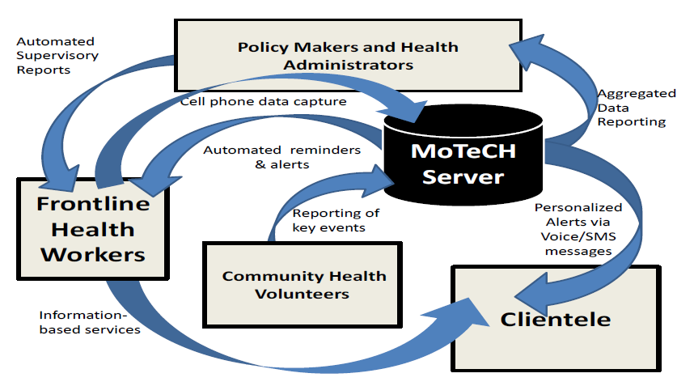
The central goal of MoTeCH is to transform Health Management Information System operations from a data extraction operation to an information support system for all key stakeholders.
The data capture is managed by front line workers who have limited capacity mobile phones that update a server database. The server, in turn, supports workers and mothers with alerts and reminders, and feeds back reports to workers, supervisors, managers and policy-makers, mechanizing previously cumbersome capabilities for information to support services, supervision, management, and planning.

Slide 5
Features of typical MoTeCH-based applications: (Continued)
Communicate information to patients via voice or SMS according to a schedule of care defined for the patient’s condition, e.g.:
Reminders for ANC appointments, lab visits, etc.
Reminders to take medication on schedule, e.g., DOTS, ART, etc.
Reminder notices to take children for scheduled immunization services
Collect data from patients or caregivers, e.g.:
Patients report their symptoms prior to treatment or during treatment (adverse events)
Patients give feedback on service delivery
Caregivers report what service was delivered to a patient and on what date

Slide 6
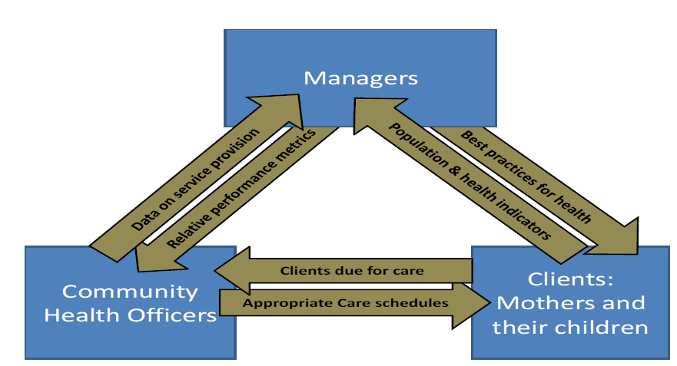
Features of typical MoTeCH-based applications: (Continued)
Alert caregivers of the status of their patients, e.g
Notify Community Health Worker when patient has not taken ART, DOTS or other drugs
Notify nurse when patient has not kept a scheduled appointment (e.g., ANC visit)
Facilitate communication between patients, caregivers, and/or health administrators, e.g.:
Establish secure peer networks for patients who share similar health concerns
Initiate conversations between patients and caregivers in a way that allows the caregiver to manage the workload effectively

Slide 7
MoTeCH SYSTEM
It is composed of three components that are posited to improve the efficiency and effectiveness of community health workers operations:
The development and deployment of a Simplified Register, which centralizes the recording of health data in a significantly reduced number of books.
The development of a mobile-phone based health information system for health workers, which automates the production of monthly activity reports and provides alerts and reminders about possible defaulters and
The implementation of a mobile-phone based health promotion module, which provides pregnant women and mothers of newborn with key information required to enhance the quality and frequency of patient-provider interaction as well as alerts and reminders of upcoming or missed care events.

Slide 8
MoTeCH SYSTEM (Continued)
The MoTeCH application combines existing software systems for mobile data collection, electronic medical records, and interactive voice response (IVR) to bridge the health information gaps.
MoTeCH uses the
OpenMRS (www.openmrs.org) software for maintaining the individual level client data,
OpenXData (www.openxdata.org) software for data collection on low-cost mobile phones and
IntelliIVR (www.yo.co.ug ) application for Interactive-Voice-Response (IVR) messages to patients.

Slide 9
MoTeCH Architecture
MoTeCH consists of the core platform and several modules, each providing use of a technology such as SMS or email, or access to an external system such as CommCare.
Organizations can choose to install one or more modules, and developers can extend MoTeCH by writing new modules.
MoTeCH is written in Java. It depends on open source systems including Apache Tomcat, Apache ActiveMQ, and Quartz.

Slide 10
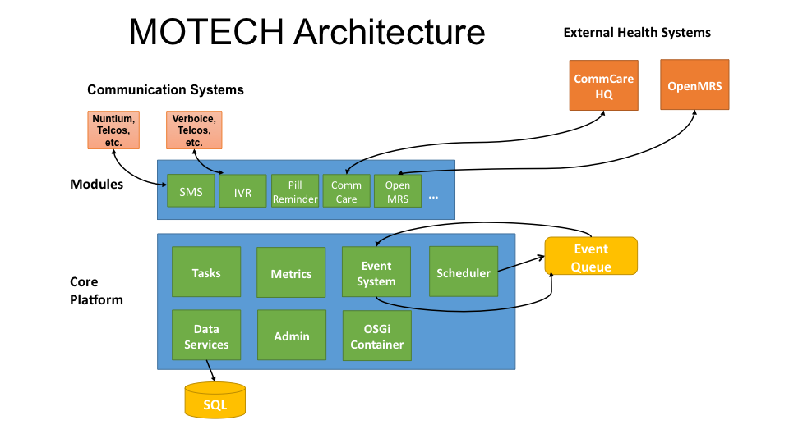

Slide 11
MoTeCH Architecture
Metrics:
Displays web site metrics using logging and the open source tools StatsD and GraphiteScheduler
Publishes events on a schedule, using the open source Quartz engine.
SMS:
Provides a basic specification for integrating the MoTeCH platform with an SMS provider to send/receive SMS messages
Tasks:
Responds to specified triggers; for example, a task can be set to enroll a patient in an alerts schedule in response to an incoming SMS message with a particular subject

Slide 12
Core Architecture
Core
Modules
Implementations

Slide 13
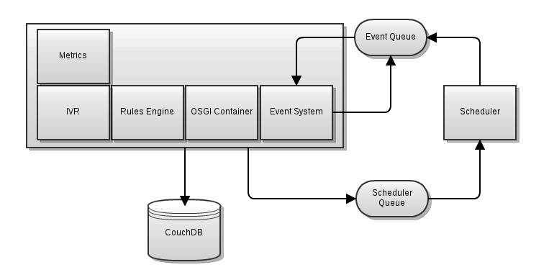
Core Architecture (Continued)
MoTeCH is designed to be horizontally scalable with multiple MoTeCHs all acting as
workers connecting to the same message queue. The CouchDB is a shared resource
as is the scheduler - both are able to be clustered to serve higher loads.

Slide 14
Core Architecture (Continued)
Core Layer
It wraps several well known open source systems and augments and exposes their features to the layers above it.
The main functions at the core layer are to wrap ActiveMQ (which provides the message queue) and present an internal pub/sub like event interface to the module and implementation layers.
The core also provides a module loading environment (OSGi) an interface to the scheduler and access to the database(CouchDB) .

Slide 15
Core Architecture (Continued)
Module layer
Its a collection of reusable components that can be loaded into a MoTeCH deployment.
Implementation layer
Its a logical layer that contains implementation specific code.
In reality it is implemented exactly the same as a module only the logic contained within that module is only applicable to a single implementation.

Slide 16
Modules
Modules within MoTeCH are self-contained bits of functionality that are loaded into the server via the OSGi host.
They interact with the core platform through its APIs and with other modules either through their service interfaces or by consuming their events.
They can expose a service interface of their own as well as emit their own events.
They may also register servlet controllers which allow them to respond to HTTP requests.

Slide 17
Stateless
A core design principle of the MoTeCH platform is that the server should be stateless across requests to allow for horizontal scalability.
It is expected that code running within the MoTeCH server should perform a single action per request and then return.
The module should never persist any state in memory and expect that state to be available to later requests.

Slide 18

Events
To aid in the development of stateless services the MoTeCH engine provides a pub/sub like event system.
The event system helps to decouple emitters of events from the modules that wish to consume them.
Any module can emit an event by calling the eventRelay and passing it a MoTeCHEvent and a subject.
To register for an event a module just needs to annotate a method with the list of event subjects or interest.

Slide 19
Scheduled Events & Timers
To assist in the development of a stateless event based server the MoTeCH platform provides access to a flexible scheduling system.
Using the open source Quartz engine applications written on MoTeCH can easily schedule events for future consumption.

Slide 20
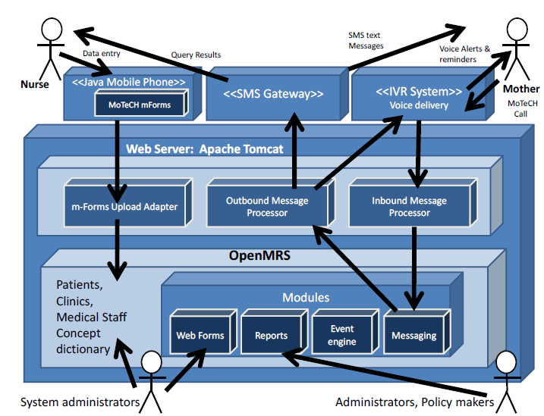
The data flows that MoTeCH software integrates into a cohesive system
Architecture of MoTeCH

Slide 21
Modules Architecture
Reasons to create a module include developing application-specific UI, business logic, and data models.
Another reason is to develop generic reusable functionality to share with the MoTeCH community.
Through MoTeCH Data Services, a modules may expose entities from its data model.
This allows a module to provide a data editor, REST APIs, record-level security, and field-level auditing.
Via the Tasks system, modules can expose triggers, data and actions to be orchestrated by other modules.

Slide 22
Modules
Alerts : Collects alerts for users in an inbox-like container
Appointments : Provides appointment scheduling and reminding
Batch : An implementation of Spring batch (version: 3.0.0.M3); it essentially deals with scheduling triggering of jobs
Call Flow : Manages the sequence of greetings and prompts for an Interactive Voice Response (IVR) call
CMS Lite : Provides basic content storage and retrieval
CommCare : Integrates the MoTeCH platform with CommCareHQ, an open-source platform to help manage community health workers
Data Services : Integrates data from external data sources and provides sharable data schemas
Email : Sends and logs email messages
Event Logging : Allows MoTeCH modules to easily see each others’ events
Event Aggregation : Groups common events and republishes them as a single event at a specified time
Hindi Transliteration : Supports transliteration of English strings to Hindi using ITRANS encoding
Hub : Provides an implementation of the PubSubHubbub Hub spec; exposes an API so other modules can act as publisher and make contents available to it for distribution

Slide 23
Modules (Continued)
Message Campaign : LEnrolls users in message campaigns with flexible content-scheduling rules
mTraning : Provides data containers and APIs for defining mobile (e.g. SMS or IVR-based) training courses and tracking user enrollment and progress
Mobile Forms : Supports configurable forms and data collection through mobile devices that support the OpenXData format
MRS (Medical Record System) : Provides a basic specification for integrating the platform with a medical record system
OpenMRS : Integrates the MoTeCH platform with OpenMRS, an open source electronic medical record platform
Outbox : A voicemail-like messaging system for end users
Pill Reminder : A flexible reminder system that may be used to alert patients when it is time to take their medications
Schedule Tracking : Enrolls users for alerts based on complex scheduling rules

Slide 24
Modules (Continued)
Decision Tree[Deprecated] : Provides APIs for constructing an IVR decision tree
IVR : Integrating the MoTeCH platform with a Interactive Voice Response (IVR) providers thus enabling support for voice/audio dialogs
IVR Asterisk : Connects the MoTeCH platform IVR with an Asterisk server using the VoiceGlue VoiceXML browser
IVR Kookoo : Integrates the MoTeCH platform with Kookoo’s hosted IVR service
IVR Verboice : Integrates the MoTeCH platform with Verboice’s hosted IVR service
IVR Voxeo : Integrates the MoTeCH platform with Voxeo’s hosted IVR service
SMS : Provides a basic specification for integrating the MoTeCH platform with an SMS provider to send/receive SMS messages
SMS HTTP : Allows platform to integrate with an HTTP-based SMS gateway to send SMS messages
SMS SMPP : Allows platform to integrate with an SMPP-based SMS gateway to send/receive SMS messages
Tasks : Allows administrative users to author simple “tasks” that wire up different modules; for example, a task can be created to enroll a patient in a message campaign in response to an incoming SMS message containing specific text

Slide 25
Description of Some Modules
Alerts Module
Alerts can be thought of as notifications which should be displayed to a MoTeCH user based on some criteria. Alerts raised within this module are not actually published or communicated to the end user. Instead the Alerts Module is a data container and service for storing, tracking, and responding to alerts.
The alert module gives the following functionality:
Creation of alerts targeting a specific entity (user)
Setting alert type, status and priority
Search for alerts
Associate custom data with an alert
Acknowledge alerts as read or closed
Update an existing alert

Slide 26
Description of Some Modules (Continued)
Appointments Module
The Appointments Module stores the schedule of reminders that are associated with an appointment (or other scheduled patient activity). It raises events for those reminders at the appropriate time. This module is used to trigger actions that may need to happen relative to a particular fixed date appointment. The module exposes an API which allows implementers to create, retrieve, edit, and delete events. Events can be stored with additional arbitrary data, including patient ID, appointment ID, voice tree, etc.
The Appointments module gives the following functionality:
Create a calendar of appointments and associate it with an entity
Remove a calendar of appointments and visits to/from an existing calendar
Confirm/Reschedule an appointment
Mark an appointment as attended/Missed
Track visits and remind users to schedule a firm date for an appointment
Track firm appointments and remind users about them

Slide 27
Description of Some Modules (Continued)
CMSLite Module
A very simple CMS that allows for content to be entered and served. Content should be associated with a key and include attributes such as language and format. Content is provided both via API and HTTP. Content can be accessed in a single return value or streamed.
The CMS Lite module gives the following functionality:
Name content and associate it with a language
Associate either strings or streams with content
Test for the existence of content
Load or stream content via API or HTTP

Slide 28
Description of Some Modules (Continued)
Decision Tree
The Decision Tree exposes APIs and a data format that allows for the expression of content trees. A content tree can then be played for a user through multiple IVR, SMS or HTTP interfaces. The content tree can provide users with audio dialogs, interface with data stored by other modules in MoTeCH and record user respones as well as the path traveled through the tree.

Slide 29
Description of Some Modules (Continued)
IVR Platform Module
The IVR module acts as a basic framework for implementing IVR functionality in the platform. The module provides one implementation of an IVR service that connects to an Asterick server using VoiceGlue VXML browser.
The IVR Platform module allows implementers to:
Set the phone number to call
Set the time out value for the call
What to do (event) when the call is successful/busy/not answered.
What to do (event) when the call failed for some other reason.

Slide 30
Description of Some Modules (Continued)
IVR Voxeo Module
IVR Voxeo is an implementation specific module that provides IVR service by utilizing Voxeo's IVR server. The Voxeo module tracks the progress of both incoming and outgoing phone calls and stores that information in a CouchDB repository. Events are published to indicate call results. Listeners may subscribe to these events and handle them in an implementation specific fashion.
Implementers can use the the Voxeo module to accomplish the following:
Initiate a call to a phone number with specified content.
Track the progress of incoming and outgoing calls.

Slide 31
Description of Some Modules (Continued)
IVR Kookoo Module
IVR Kookoo is an implementation specific module that provides IVR service by utilizing Kookoo's Service (kookoo.in).
Kookoo is India based Telephony service provider which has REST based APIs for call and SMS.
The Kookoo module supports decision tree based IVR for both incoming and outgoing phone calls and stores that information in a CouchDB repository.
Events are published to log call detail record. Listeners may subscribe to close call events and handle them in an implementation specific fashion.

Slide 32
Description of Some Modules (Continued)
Message Campaign Module
The MoTeCH message campaign module is used to enroll users into messaging campaigns.
A user may be a patient, worker, lab, facility, or other desired recipient of the information to be disseminated. A campaign is a course of informational messages that are sent to the target user on an assigned date or schedule. A user can be entered into a campaign at any point during its duration via a Campaign Request. Users may be removed or re-enrolled into campaigns. The languages and formats of the campaign messages can be specified (IVR, SMS, English, etc). Campaign messages follow a clearly defined schedule and are automatically triggered by the scheduling system.

Slide 33
Description of Some Modules (Continued)
Mobile Forms Module
Mobile forms module helps offline data collection and uploading to server
Mobile forms API module is server component to enable form serving and data upload. Mobile forms J2ME app downloads form definitions from the mobile forms API module and enables data collection. Forms are configurable thought XML and classified by form groups.

Slide 34
Description of Some Modules (Continued)
MRS (Medical Record System) Module
The MRS API module provides a generic, lightweight API for interacting with medical record systems. Out-of-the-box, the module has several service interfaces that clients can use to interact with medical record systems. In addition, the module contains a well defined data model for storing and accessing patient information.
The terminology within the MRS API data model is similar to the OpenMRS project.
MRSPerson - An individual in the MRS, e.g. a patient, provider of care, or user of the system. A person includes first name, last name, address, date of birth, and gender.
MRSPatient - A person who is registered as a patient in the MRS
MRSEncounter - When a patient visits a hospital or health clinic, or more generally, any interaction between a patient and health care worker. An encounter includes a date, a patient and number of observations.
MRSObservation - Something measured or observed during an encounter. Examples include: weight, temperature, and pulse.
MRSFacility - A physical place where an encounter can occur, e.g. hospital or health clinic.

Slide 35
Description of Some Modules (Continued)
Outbox Module
The outbox module acts as a repository of pending and saved voice messages for the client. The module provides a service for the retrieval and manipulation of messages and information from a party's outbox. A party could be a patient, nurse, doctor, etc. The module provides event handling that allows for the scheduling or unscheduling of voice messages for a specific time of day. Implementers may configure some of the details regarding the outbox's limits (for example, the maximum number of messages in the outbox may be configured).
The outbox module gives the following functionality:
The retrieval and manipulation of information and messages from a party's outbox using a voice outbox service
Configuration of the outbox's properties
Scheduling and unscheduling voice messages using events
Specification of the outbox voice message menu templates
Pending and saved OutboundVoiceMessages are stored in CouchDB.

Slide 36
Description of Some Modules (Continued)
Pill Reminder Module
The Pill Reminder Module provides repeated reminders about pill regimens to users. Users are enrolled in a regimen and then reminded to take the appropriate medicines at the appropriate times of the day. User responses are tracked and adherence to the prescribed regimen can be calculated.
The Pill Reminder module gives the following functionality:
Enroll users in a custom pill regimen
Custom per-user reminders for specific medicines at during defined time windows
Track users adherence to a pill regimen

Slide 37
Description of Some Modules (Continued)
Schedule Tracking Module
The schedule tracking module allows a client to be enrolled in a clearly defined schedule. Schedules consist of specified "milestones." Milestones represent windows of time in which certain criteria, treatments, courses, etc. should be fulfilled before moving on to the next milestone. Clients enrolled in these schedules are sent alerts when they are due, late, or past due on the period of schedule fulfillment. Clients may be enrolled in an unlimited number of schedules, but they can only be active in one enrollment for a given schedule.
A schedule defines a set of milestones that should be fulfilled in specified windows of time. Implementers can use the schedule tracking module to accomplish the following:
Enroll a particular client in a schedule for a specific duration. This is accomplished by means of the schedule tracking service.
Send alerts to clients that have been enrolled in a schedule.
Define JSON documents that specify a schedule and its set of milestones.
Query for client enrollments in schedules based on specific criteria.
Client enrollments are stored in CouchDB.

Slide 38
Description of Some Modules (Continued)
SMS API Module
The SMS API module provides implementers with an event-driven SMS framework.
The SMS module alone is not enough to send SMS messages; an accompanying listener must also be included or implemented.
SMS HTTP Module
The SMS HTTP module is an SMS implementation that helps to send and receive SMS through HTTP via a specified SMS provider.
SMS SMPP Module
The SMS-SMPP module is an SMS implementation that handles send SMS events that were raised by the SMS-API module. Its purpose is to send SMS messages over SMPP to a specified SMS provider that is responsible for dispatching the message.

Slide 39
Event and Scheduler Architecture
Event Handling and Scheduling among Modules
The following diagram provides three examples of MoTeCH modules:
MoTeCH module A publishes events, schedules new jobs and listens for events. An example of a MoTeCH platform that has these three responsibilities is the Message Campaign module.
MoTeCH module B schedules new jobs.
MoTeCH module C listens to events of subject X and Y: listener X listens to events of subject X, and listener Y listens to events of subject Y.

Slide 40
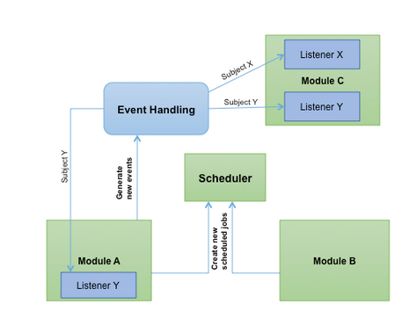
Event Handling and Scheduling among Modules

Slide 41
Event and Scheduler Architecture (Continued)
Event Handling and Scheduling Architecture
There are currently two ways to schedule a job in MoTeCH :
Using the MoTeCHSchedulerGateway (see Fig. A) , found in a global Context object defined in the server module, to pass scheduled jobs as JMS messages to a schedule queue. The queue will dequeue these events and the implementor must provide an inbound channel to accept and route the jobs to the scheduler of their choice.
Another method (see Fig. B) invokes the MoTeCHSchedulerService found in the Scheduler module directly. The service in this case is injected into the class that uses it. This service employs Quartz to schedule MoTeCHScheduledJobs. When triggered, MoTeCHScheduledJobs raise events that are sent to an event queue. These messages are dequeued and then received by a consumer, the event relay, which in turn discovers all of the listeners on the event and invokes the appropriate method that was listening on that event.

Slide 42
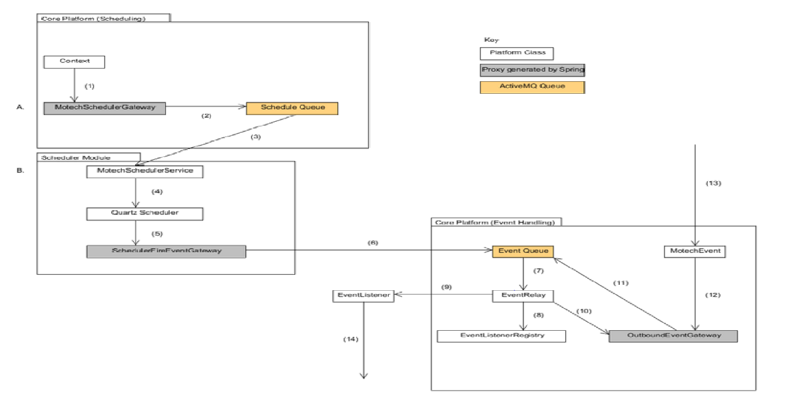
Event Handling and Scheduling Architecture

Slide 43
Event Handling and Scheduling Architecture (Continued)
1. In order to use the MoTeCHSchedulerGateway, the implementor must retrieve it from the MoTeCH Context bean defined in applicationPlatformServer.xml (in the motech-platform-server-api module).
2. The MotechSchedulerGateway is generated by Spring at runtime. It is configured in outboundScheduleJobChannelAdapter.xml (in the motech-platform-server-api module). JMS messages are sent to an active MQ queue, defined in the activemq.properties file (in the motech-platform-server module).
3. The schedule queue will dequeue the messages and send them to consumers. The core platform does not have any consumer for the schedule queue. Implementors would have to define these consumers unless they use the scheduler module. The scheduler module provides a MotechSchedulerService that receives these messages. The configuration file schedulerInboundChannelAdapter.xml (found in motech-platform-scheduler) specifies an inbound channel adapter that routes the payload, based on its type, to the scheduler service. Currently, unscheduleJob from the MotechSchedulerGateway is unsupported, and the service provides several methods not found in the gateway.
4. The scheduler service retreives the Quartz Scheduler from the SchedulerFactoryBean. The service can only schedule MotechScheduledJobs, which all must include a MotechEvent.
5. When the trigger for the scheduled job is satisfied, the job is executed and the accompanying Motech event is sent to the SchedulerFireEventGateway interface. This gateway is defined in schedulerFiredEventChannelAdapter.xml and a proxy is generated by Spring at runtime.
6. The SchedulerFireEventGateway serves as an outbound message gateway to shuttle messages to an adapter that then sends JMS messages to the event queue.

Slide 44
Event Handling and Scheduling Architecture (Continued)
7. The event queue dequeues messages and routes them to its consumers. The core platform has one consumer for events, a channel that routes messages to an EventRelay interface (implemented by ServerEventRelay) which accepts the dequeued MotechEvent objects. This is configured in inboundEventChannelAdapter.xml (found in motech-platform-server-api). ServerEventRelay's relayEvent method is not a method found in its interface, EventRelay.
8. The event relay retreives the listeners that are listening on the motech event it is relaying (listening is based on the value bound to the motech event's subject key).
9. If the event has a specific destination or only one listener, the listener's handle method is called. This will invoke the method that was annotated as a MotechListener. These listener classes can be project specific and will reside outside of the core platform.
10. If the event has multiple listeners, a separate event is raised for each listener and sent to the outbound event gateway. The original event object is not handled by a listener in this case.
11. The outbound event gateway, defined in outboundEventChannelAdapter.xml (motech-platform-common), routes the JMS message to the event queue. Each message is then dequeued and sent to the consumers, as in step 7.
12. and 13. The OutboundEventGateway, which is responsible for shuttling events to the event queue, may receive project specific events from outside of the platform. These are all handled identical to steps 7-11.
14. The EventListener's handle method will invoke the method that was annotated as a MotechListener. The MotechEvent will be passed to that method as a parameter.

Slide 45
Resources Used:
The Architecture of a Software System for Supporting Community-based Primary Health Care with Mobile Technology: The Mobile Technology for Community Health(MoTeCH) Initiative in Ghana[Bruce MacLeod, James Phillips, Allison E. Stone, Aliya Walji, John Koku Awoonor-Williams]
The Mobile Technology for Community Health (MoTeCH) Initiative: An m-Health System Pilot in a Rural District of Northern Ghana (Working Draft) [John Koku Awoonor-Williams, James F. Phillips, Allison Stone, Stephane Helleringer, Bruce MacLeod, Jemima Frimpong, Maggie Schmitt]
MoTeCH Specifications Power Point
http://www.motechproject.org/
http://test-motech.readthedocs.org/en/latest/index.html

